Slide 1
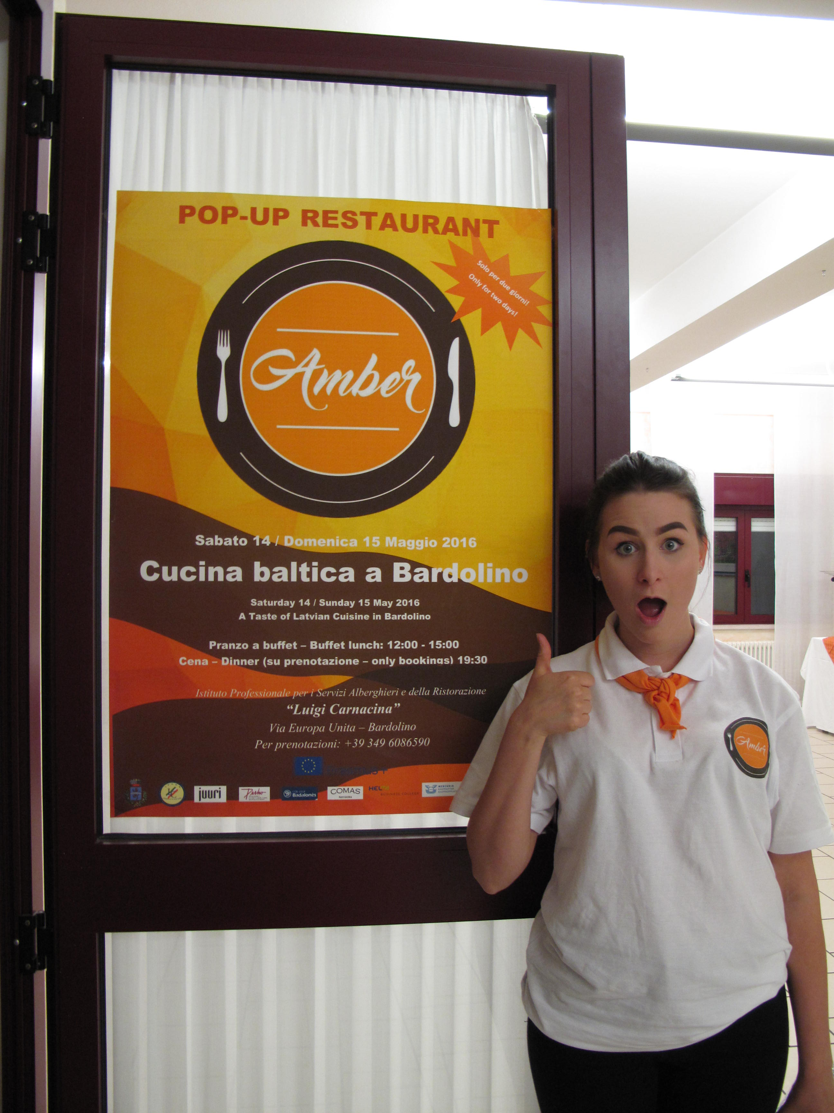
CULINARY CARAVAN ON THE MOVE – Building up International eLearning Entrepreneurship Platform Helmi Business & Travel College - Markus Oedewald, Minna Jalonen, Leni Palminkoski-Pihlamo

Slide 2
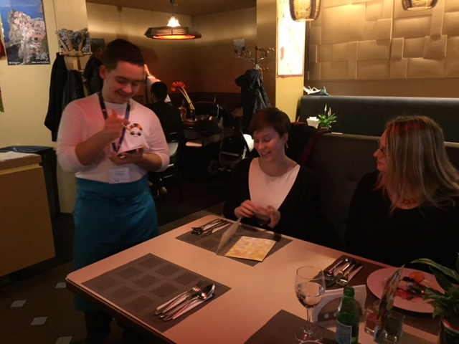
Main objectives
1) CREATE a new international, inspiring, practical and DIGITAL eLEARNING ORIENTED PEDAGOGICAL MODEL - eLEARNING WITH POP UP COMPANY MODULE - in English to learn entrepreneurship in vocational education
a. study entrepreneurship (15 ECTS) in English by new eLearning model
b. establish a real Street food pop up restaurant with colleague students from participating countries
c. restaurant entrepreneurs coach students
2) CREATE A REAL Street food pop up restaurant in Finland, Spain, Italy and Latvia.
3) UNITE European vocational curriculums of participating schools (Finland, Spain, Italy, Latvia) with international Working as Entrepreneur module (15 ECTS).
4) DISSEMINATE a new PEDAGOGICAL MODEL TO STUDY ENTREPRENEURSHIP to new countries outside Europe (incl. e.g. Jordania) with the use of filming the whole concept and inviting observers to pop up restaurants.
As a broader objective this project will impact also to entrepreneurship education and establishing new sustainable companies especially in third world countries as we hope to able to export European entrepreneur education with this new model.

Slide 3
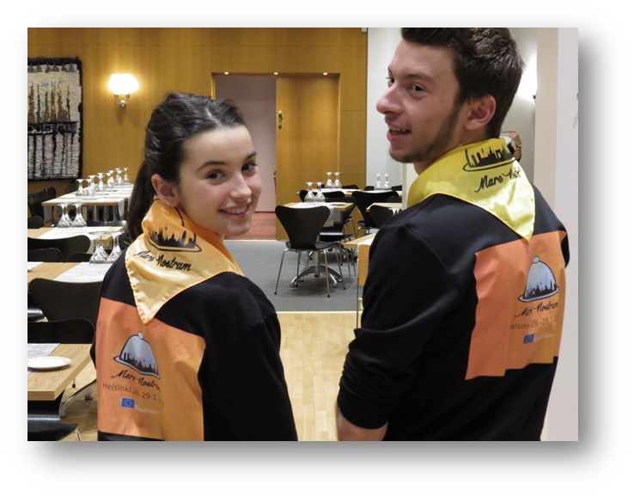
Main idea of the project
During this project students will become experts in entrepreneurship by creating 4 different street food pop up restaurants (open 2 days) in 4 different countries (= 4 WORKSHOPS/Street food pop up restaurants).
STEP1 - PLAN
With eLEARNING MODEL approx. 25 students of 4 countries will create in 2-3 months a STREET FOOD POP UP RESTAURANT BUSINESS PLAN incl. e.g means of competition, name, pay attention to local legal issues, learn cultural communication.
- This eLearning model include guidance of students by teachers and restaurant entrepreneurs.
- Business students focus especially on creating business plan and marketing and restaurant services students will put especially effort into creating a menu, order food etc.
STEP2 - ESTABLISH AND FILM
Students will in practice ESTABLISH AND RUN THEIR STREET FOOD POP UP RESTAURANT for 2 days in foreign country (WORKSHOP1 first restaurant in Finland with Finnish Street food cuisine).
- Finnish restaurant entrepreneur and teachers will coach students in their pop up restaurant.
- Restaurant services students will take care of cooking and waitering and business students of marketing, filming the whole concept and helping in general.
- After vocational skills demonstration all the students of 4 countries get 15 ECTS to their studies for passing Working as a entrepreneur module.
STEP 3-8 - ESTABLISH AND DISSEMINATE
This same concept will be done in Spain (WORKSHOP2), Latvia (WORKSHOP3) and Italy (WORKSHOP4).
- During the last two WORKSHOPS in Latvia and Italy also participants from outside Europe will be invited into WORKSHOPS as observers on the spot or through internet as the whole concept will be broadcasted online through internet.
STEP 9 –DISSEMINATE MORE
The film - TOGETHER WE CAN – eLEARN HOW TO CREATE A INTERNATIONAL COMPANY - will be published by the last spring of the project (1-6/2018) and disseminated through social media to all over the world in order to export European entrepreneur education.

Slide 4
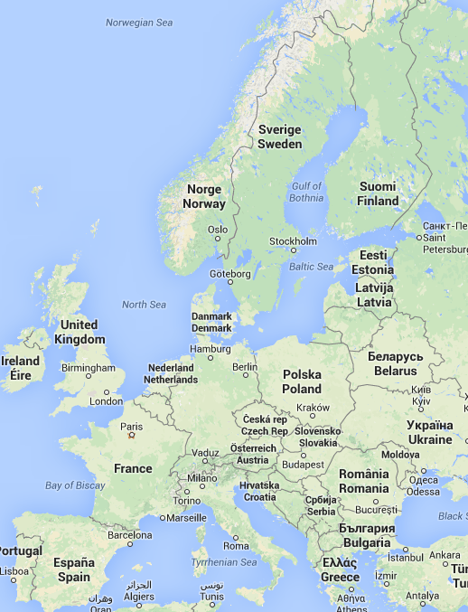
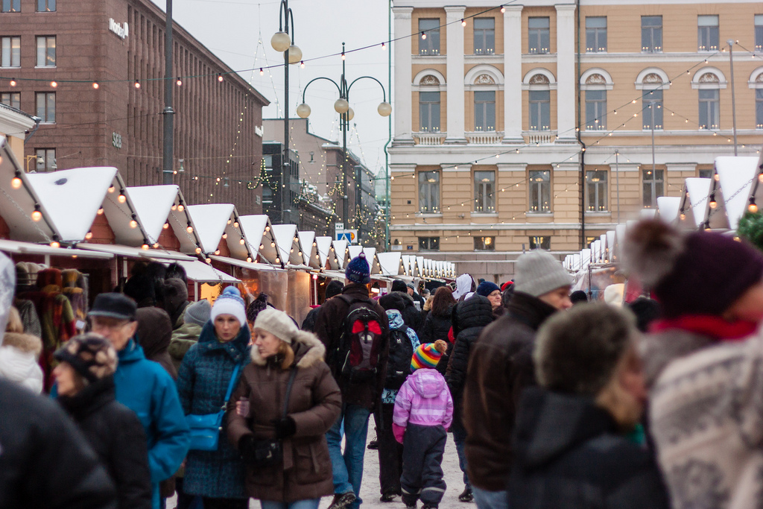
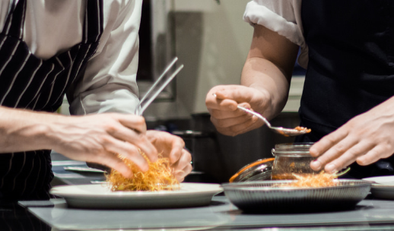
Culinary Caravan on the Move
Pop up restaurant Barcelona (5/2017)
Pop up restaurant Helsinki (12/2016)
Pop up restaurant Bardolino (5/2018)
Pop up restaurant Riga (12/2017)

Slide 5
Participants in WORKSHOPS and Project Group Meetings
1. WORKSHOP 1 - December 2016 – Restaurant in Finland (Christmas market)
a. Mobilities: Italy, Spain, Latvia (1 teacher+ 3 students/school Total: 6 + 18 =24)
b. + at least 9 local students + 3 local teachers + local cameraman
2. WORKSHOP 2 - May 2017 – Restaurant in Spain
a. Mobilities: Finland, Italy, Latvia (1 teacher + 3 students/school (Finland only 2 teachers + 6 students in total + cameraman) Total: 6+19=25
b. + at least 6 local students and 2 local teachers
3. WORKSHOP 3 - December 2017 – Restaurant in Latvia (Christmas market)
a. Mobilities: Finland, Spain, Italy (1 teacher + 3 students/school (Finland only 2 teachers + 6 students in total + cameraman) Total: 6+19=25
b. + at least 6 local students and 2 local teachers
4. WORKSHOP 4 - May 2018 – Restaurant in Italy
a. Mobilities: Finland, Spain, Latvia (1 teacher + 3 students/school (Finland 3 teachers + 6 students in total + cameraman) Total: 7+19=26
b. + at least 6 local students and 2 local teachers
5. PROJECT GROUP MEETINGS (Transnational meetings)
a. September 2016 – Finland (Mobilities: 1 coordinator/school Total 6 & 3 local coordinators)
b. December 2016 – Finland (Mobilities: 1 coordinator/school Total 6 & 3 local coordinators)
c. May 2017 – Spain (Mobilities: 1 coordinator/school Total 7 & 2 local coordinators)
d. December 2017 – Latvia (Mobilities: 1 coordinator/school Total 7 & 2 local coordinators)
e. May 2018 – Italy (Mobilities: 1 coordinator/school Total 7 & 2 local coordinators)
6. FINAL SEMINAR
a. June 2018 – Finland (Mobilities: 1 coordinator/school Total 6 & 3 local coordinators)
NO MOBILITY TO ABROAD BUT DIRECTLY INVOLVED IN THE PROJECT
RESTAURANT ENTREPRENEUR FROM EACH COUNTRY: Restaurant Juuri (Finland), Sapori d’Italia (Italy), Golfa Kluba Restorans (Latvia), (SAÜC (Spain)) will participate in eLearning platform as a coach and will be coach during WORKSHOP in their home country. There will be 4 RESTAURANT ENTREPRENEURS INVOLVED IN THE PROJECT DIRECTLY.

Slide 6
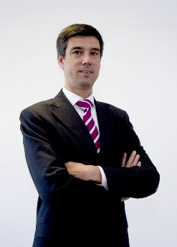
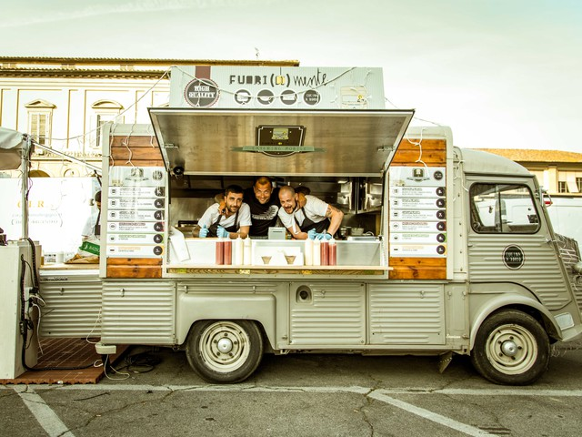
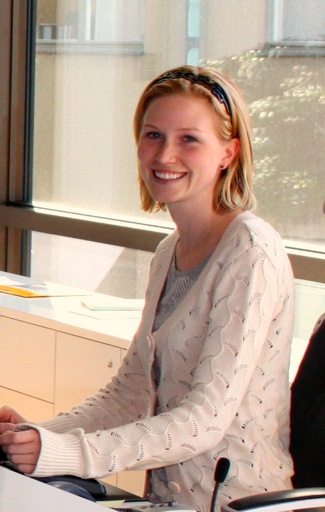
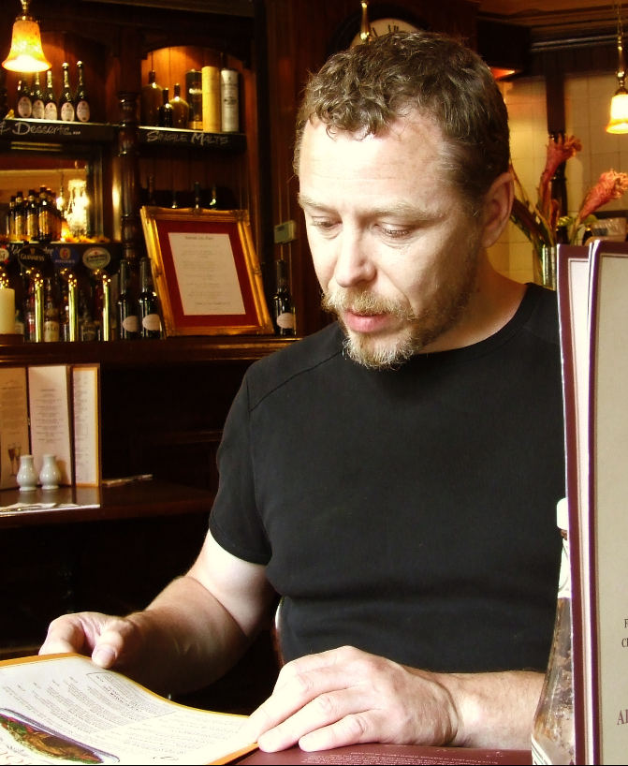
NEW INTERNATIONAL, INSPIRING, PRACTICAL AND DIGITAL ELEARNING ORIENTED PEDAGOGICAL MODEL eLEARNING WITH POP UP MODULE TO LEARN ENTREPRENEURSHIP
Participates pop up restaurant workshops
Guides students in Pop up restaurants
Student
Restaurant entrepreneur
Teacher
Participates in local pop up restaurant workshops
Spars students in their pop up restaurant
Observer
Finnish business teachers implement the learning process of all students of Working as Entrepreneur module (15 ECTS)
Local teachers guide students of her own school before WORKSHOP with this platform and materials
Documents assessment here
Communicates with students, colleague teachers and restaurant entrepreneurs
Spar&guides students with their business idea and menu
Communicates with students and teachers
Interested organizations will be invited to observe the WORKSHOPS 3-4 and they can follow the project online as the concept will be filmed during the learning process
- Studies entrepreneurship with colleague students from Finland, Spain, Latvia and Italy
- Communicates with teachers, restaurant entrepreneurs and colleague students
- Gets assessment here
- Gives feedback
- Establishes and runs ONE pop up restaurant with international colleague students
- Film the workshop happenings
eLearning Platform 24/7
Communication (chat & Skype for Business)
Entrepreneurship study materials (Working as Entrepreneur)
Guidance of students by teachers and restaurant entrepreneurs
WORKSHOPS: 1) FINLAND, 2) SPAIN, 3) LATVIA AND 4) ITALY
ESTABLISH AND RUN STREET FOOD POP UP RESTAURANT
Assessment
Collecting feedback
Coordinator
Customer
- Takes care of budget
- Plans feedback, collects it, analyzes it and plans changes
- Uses also OneDrive for collecting material (linked to eLearning Platform 24/7
- 500 customers is estimated to visit each Street food pop up restaurant. So total 2000 customers from Finland, Spain, Latvia and Italy !

Slide 7
WELCOME ALONG TO CULINARY CARAVAN!

